Slide 1

AAE 875 – Fundamentals of Object Oriented Programming and Data Analytics
Cornelia Ilin, PhD
Department of Ag & Applied Economics
UW-Madison
Week 1 - Summer 2019

Slide 2

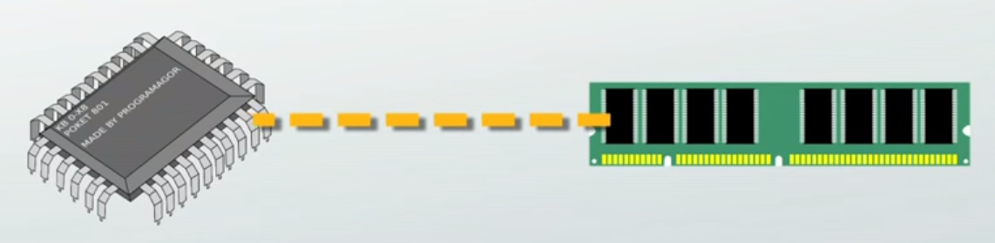
Programming languages - Types
'low' because they are very close to how different hardware elements of a computer communicate with each other
Require extensive knowledge of computer hardware and its configuration
Low-level
Created in 1940s

Slide 3
Programming languages - Types
The only language directly understood by a computer; does not need to be translated (by a compiler or interpreter – more on this later)
All instructions use binary notations and are written as strings of 1s and 0s
However, binary notation is very difficult to understand -> develop assembly language to make machine language more readable by humans
Low-level
011 1100001 001001 1100010
Machine language
Assembly language
'machine code'

Slide 4
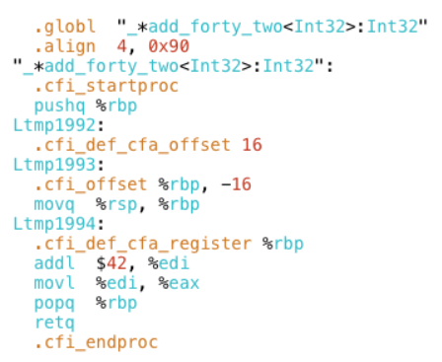
Programming languages - Types
Consists of a set of symbols and letters
Requires an assembler to translate the assembly language to machine language
A second generation because it no longer requires a set of 1s and 0s to write instructions, but terms like:
Assemblers automatically translate assembly language instructions 'Mul 97, #9, 98', into machine code (011 1100001 001001 1100010).
Easier than machine language but still difficult to understand -> develop high level languages
Low-level
Machine language
Assembly language
Mul 97, #9, 98
Add 96, #3, 92
Div 92, #4, 97

Slide 5
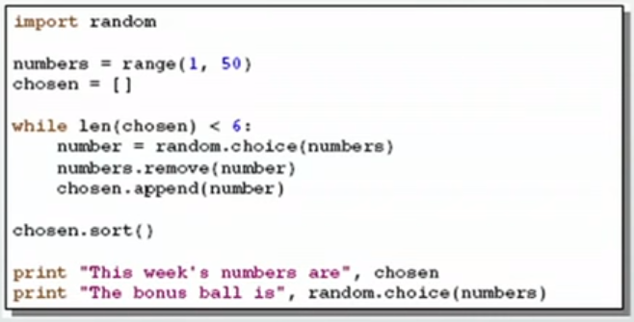
Programming languages - Types
Uses English and mathematical symbols in its instructions
This is what most programmers use these days
Examples: Fortran, Java, C++, Python
More closer to the logic of human thinking:
Low-level
Machine language
Assembly language
High-level
created in 1960s, 1970s

Slide 6
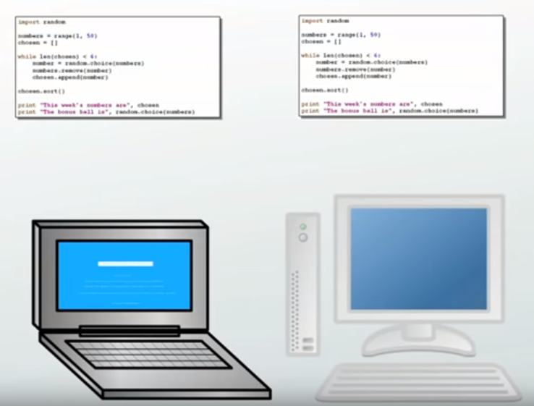
Programming languages - Types
To learn to program in a high-level language you need to learn commands, syntax, and logic, which correspond closely to vocabulary and grammar
The 'high-level' program is often portable, the same program can run on different hardware (not necessary OP)
[Both machine language and assembly language are machine specific, and not portable (the machine code has to be modified to run in another computer)]
Low-level
Machine language
Assembly language
High-level

Slide 7
Programming languages - Types
To learn to program in a high-level language you need to learn commands, syntax, and logic, which correspond closely to vocabulary and grammar
The 'high-level' program is often portable, the same program can run on different hardware (not necessary OP)
The code cannot be directly understood by a computer, it needs to be translated into machine code using a compiler or interpreter
Low-level
Machine language
Assembly language
High-level

Slide 8
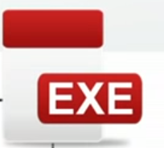
Programming languages - Types
The compiler is used to translate a high-level program into machine code (the result is an .exe file)
Once you have an executable (.exe) file you can run the program over and over again without having to compile it again (e.g. you only need to translate (compile) a movie only once and can be used many times afterwards)
Low-level
Machine language
Assembly language
High-level program
Compiler
Machine code
Code example:
num1 = 20
num2 = 9
numProduct = num1 * num2
011 1100001 001001 1100010
High-level
compiler
interpreter

Slide 9
Programming languages - Types
The compiler is used to translate a high-level program into machine code (the result is an .exe file)
Low-level
Machine language
Assembly language
High-level program
Compiler
Machine code
Once the machine code is obtained
(aka running the program), the
program then processes the input data to produce the desired output
High-level
Inputs
Run Program
compiler
interpreter
Outputs

Slide 10

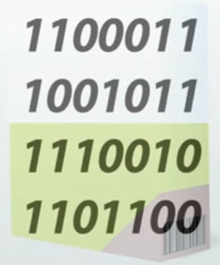
Programming languages - Types
Advantages:
-> does not reveal the original source code (possible to distribute the program w/o revealing the inner workings; when you install a software application in your computer you typically install a compiled (.exe) version of the code
Disadvantages:
-> slower than interpreter languages
Examples: C, C++, C#, Fortran, Java
Low-level
Machine language
Assembly language
High-level
compiler
interpreter

Slide 11
Programming languages - Types
An interpreter is a computer program that simulates a computer that understands a high-level language
The interpreter translates the high-level program line by line during execution, which results in the desired output data
The only result is the output data, there is no compile code
Low-level
Machine language
Assembly language
High-level program
Interpreter
High-level
Outputs
Inputs
compiler
interpreter

Slide 12
Programming languages - Types
When using an interpreter, every time you want to run the program you need to interpret the code again line by line (e.g. you translate (interpret) a speech only once and the results won't be used again)
Low-level
Machine language
Assembly language
High-level program
Interpreter
High-level
Outputs
Inputs
compiler
interpreter

Slide 13
Programming languages - Types
Advantages:
-> faster than compiler languages
Disadvantages:
-> not suitable for commercial software developments if you don't want
to reveal the source code
Examples: Python, Perl, Ruby
Low-level
Machine language
Assembly language
High-level
compiler
interpreter

Slide 14
Top Hat Question # 1
What type of programming language is Python?
(a) interpreted, low-level programming language
(b) compiled, low-level programming language
(c) interpreted, high-level programming language
(d) compiled, high-level programming language

Slide 15
Programming v. spoken languages

Slide 16
How many programming languages?

Slide 17
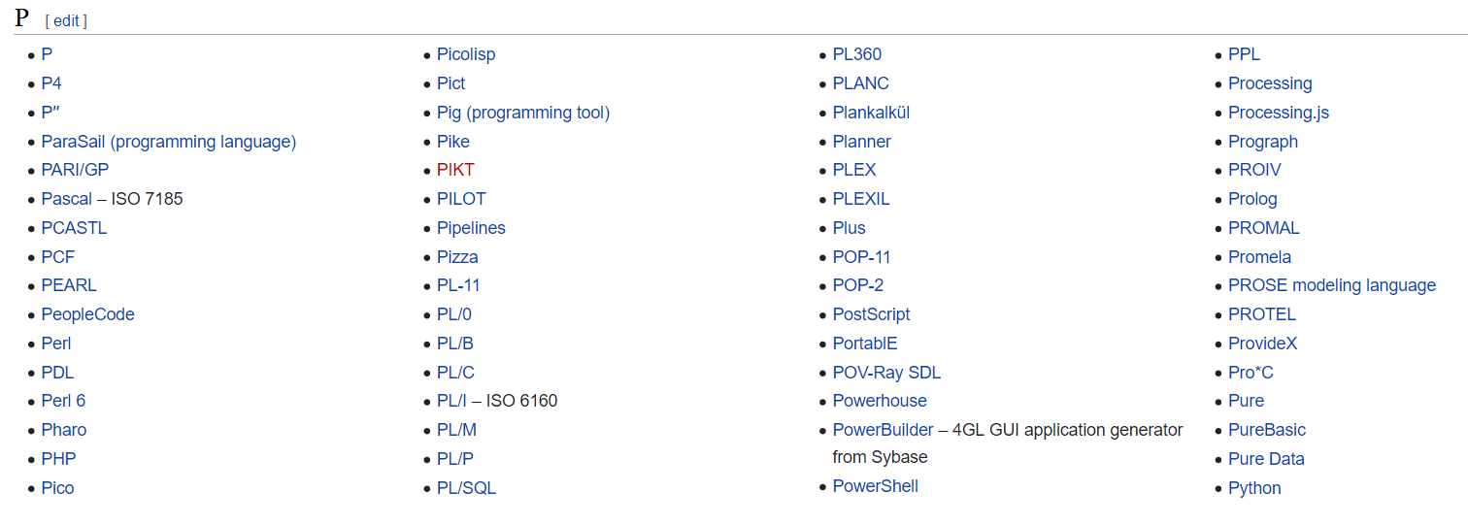
How many programming languages?
Wikipedia: over 700 'notable languages' in existence, both those in current use and historical ones
https://en.wikipedia.org/wiki/List_of_programming_languages

Slide 18
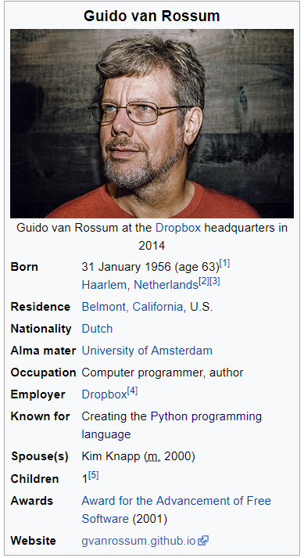
Python – language history
An interpreted, high-level programming language
Invented in The Netherlands by Guido van Rossum
Conceived in the late 1980s as a successor to the ABC language
First released in 1990 (Python 2.0)
Major update in 2008 (Python 3.0, not backward compatible,
highly preferred)
Source: https://en.wikipedia.org/wiki/Guido_van_Rossum

Slide 19
Python – language history
Its philosophy: code readability and significant whitespace
Python interpreters are available in many operating systems
Guido van Rossum is fan of 'Monty Python's Flying Circus', a famous TV show in The Netherlands
Named after Monty Payton
Open-sourced from the beginning
Source: https://en.wikipedia.org/wiki/Guido_van_Rossum

Slide 20
Chapter 1: Introduction
Programming in general
Development environment
Basic Input and output
Errors
Computer tour

Slide 21
Programming in general
A computer program = instructions (executed one at a time)
Examples of basic instructions: input ( ), process ( ), output ( )

Slide 22
Programming in general
A computer program = instructions (executed one at a time)
Examples of basic instructions: input (x = 5, y = 6), process ( x + y = 11), output (e.g. to a file)

Slide 23
Programming in general
A computer program = instructions (executed one at a time)
Examples of basic instructions: input (x = 5, y = 6), process ( x + y = 11), output (e.g. to a file)
A computer program is like a recipe (really, no difference!)

Slide 24
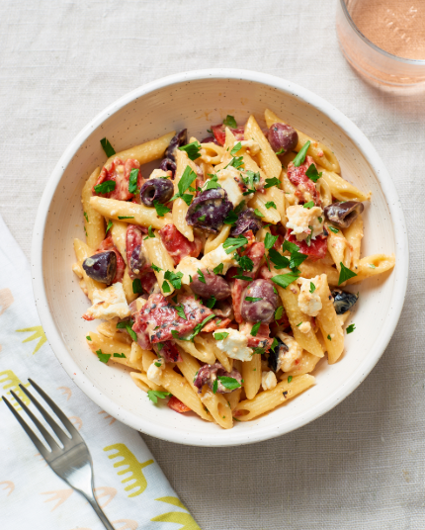
Human
Humus and Tomato Pasta
1 tbsp pf olive oil
1 tsp of whole cumin seeds
1 large chopped onion
400 g chopped tomatoes
200 g humus
150 g pasta
1. Add the pasta to a large pan of boiling water. Simmer for 10 minutes
2. Fry the cumin in the olive oil for a few minutes. Add the onions and fry gently
3. Stir in the tomatoes and the humus and leave to simmer for 5 minutes
4. Drain the pasta and serve

Slide 25
Human
Computer program
Humus and Tomato Pasta
1 tbsp pf olive oil
1 tsp of whole cumin seeds
1 large chopped onion
400 g chopped tomatoes
200 g humus
150 g pasta
1. Add the pasta to a large pan of boiling water. Simmer for 10 minutes
2. Fry the cumin in the olive oil for a few minutes. Add the onions and fry gently
3. Stir in the tomatoes and the humus and leave to simmer for 5 minutes
4. Drain the pasta and serve
Humus and Tomato Pasta
/* List of inputs */
tbsp_olive_oil = 1
chop_onion = 1
gr_chop_tomatoes = 400
gr_humus = 200
gr_pasta = 150
boiled_water = 500 ml
tsp_cumin_seeds = 1

Slide 26
Human
Computer program
Humus and Tomato Pasta
1 tbsp pf olive oil
1 tsp of whole cumin seeds
1 large chopped onion
400 g chopped tomatoes
200 g humus
150 g pasta
1. Add the pasta to a large pan of boiling water. Simmer for 10 minutes
2. Fry the cumin in the olive oil for a few minutes. Add the onions and fry gently
3. Stir in the tomatoes and the humus and leave to simmer for 5 minutes
4. Drain the pasta and serve
Humus and Tomato Pasta
/* List of inputs */
tbsp_olive_oil = 1
chop_onion = 1
gr_chop_tomatoes = 400
gr_humus = 200
gr_pasta = 150
boiled_water = 500 ml
tsp_cumin_seeds = 1
/* Pasta processing */
pan1 = boiled_water + gr_pasta
Heat(pan1, low, 10 minutes)
/*Sauce processing */
pan2 = tbsp_olive_oil + tsp_cumin_seed
Heat(pan2, high, 2 minutes)
pan2 = pan2 + chop_onion
Heat(pan2, high, 2 minutes)
pan2 = pan2 + gr_chop_tomatoes + gr_humus
Heat(pan2, simmer, 5 min)

Slide 27
Human
Computer program
Humus and Tomato Pasta
1 tbsp pf olive oil
1 tsp of whole cumin seeds
1 large chopped onion
400 g chopped tomatoes
200 g humus
150 g pasta
1. Add the pasta to a large pan of boiling water. Simmer for 10 minutes
2. Fry the cumin in the olive oil for a few minutes. Add the onions and fry gently
3. Stir in the tomatoes and the humus and leave to simmer for 5 minutes
4. Drain the pasta and serve
Humus and Tomato Pasta
/* List of inputs */
tbsp_olive_oil = 1
chop_onion = 1
gr_chop_tomatoes = 400
gr_humus = 200
gr_pasta = 150
boiled_water = 500 ml
tsp_cumin_seeds = 1
/* Pasta processing */
pan1 = boiled_water + gr_pasta
Heat(pan1, low, 10 minutes)
/*Sauce processing */
pan2 = tbsp_olive_oil + tsp_cumin_seed
Heat(pan2, high, 2 minutes)
pan2 = pan2 + chop_onion
Heat(pan2, high, 2 minutes)
pan2 = pan2 + gr_chop_tomatoes + gr_humus
Heat(pan2, simmer, 5 min)
/* Output (put it in a plate)*/
Drain(pan1)
Plate(pan1, pan2)

Slide 28
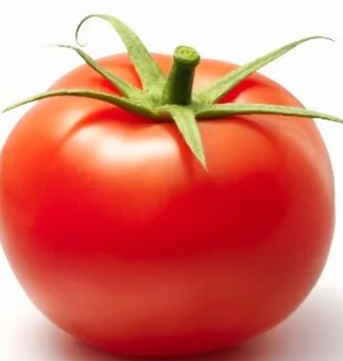
Human
Computer program
Humus and Tomato Pasta
1 tbsp pf olive oil
1 tsp of whole cumin seeds
1 large chopped onion
400 g chopped tomatoes
200 g humus
150 g pasta
1. Add the pasta to a large pan of boiling water. Simmer for 10 minutes
2. Fry the cumin in the olive oil for a few minutes. Add the onions and fry gently
3. Stir in the tomatoes and the humus and leave to simmer for 5 minutes
4. Drain the pasta and serve
Humus and Tomato Pasta
/* List of inputs */
tbsp_olive_oil = 1
chop_onion = 1
gr_chop_tomatoes = 400
gr_humus = 200
gr_pasta = 150
boiled_water = 500 ml
tsp_cumin_seeds = 1
/* Pasta processing */
pan1 = boiled_water + gr_pasta
Heat(pan1, low, 10 minutes)
/*Sauce processing */
pan2 = tbsp_olive_oil + tsp_cumin_seed
Heat(pan2, high, 2 minutes)
pan2 = pan2 + chop_onion
Heat(pan2, high, 2 minutes)
pan2 = pan2 + gr_chop_tomatoes + gr_humus
Heat(pan2, simmer, 5 min)
/* Output (put it in a plate)*/
Drain(pan1)
Plate(pan1, pan2)

Slide 29
Programming in general
Important to develop Computational thinking
What is the main objective?
What are the inputs, outputs, their relationship?
What are the different components of the solution?
Computational thinking: pseudocode it! then code it!

Slide 30
Pseudocode it!
Code it!
/* Main objective is to cook Humus and Tomato Pasta
The inputs needed include olive oil, chopped onion, chopped tomatoes, humus, pasta, water, and cumin seeds
The first output is cooked pasta obtained by adding pasta to a pan of boiling water
The second output is the pasta sauce obtained my mixing olive oil, cumin seeds, chopped onion, tomatoes, and humus in a frying pan
The components of the solution are the first output and second output
The final output is the Humus and Tomato Pasta dish */
Humus and Tomato Pasta
/* List of inputs */
tbsp_olive_oil = 1
chop_onion = 1
gr_chop_tomatoes = 400
gr_humus = 200
gr_pasta = 150
boiled_water = 500 ml
tsp_cumin_seeds = 1
/* Pasta processing */
pan1 = boiled_water + gr_pasta
Heat(pan1, low, 10 minutes)
/*Sauce processing */
pan2 = tbsp_olive_oil + tsp_cumin_seed
Heat(pan2, high, 2 minutes)
pan2 = pan2 + chop_onion
Heat(pan2, high, 2 minutes)
pan2 = pan2 + gr_chop_tomatoes + gr_humus
Heat(pan2, simmer, 5 min)
/* Output (put it in a plate)*/
Drain(pan1)
Plate(pan1, pan2)

Slide 31
Programming in general
Explain your code: Summarize and provide a high-level explanation for what your code does in plain English! Python uses the pound sign (#) for comments
Trace your code: Run the code as the computer does
Take a piece of paper (seriously!)
Write down the variables and their values
Update the variables as they change as you mentally walk through the statements sequentially

Slide 32
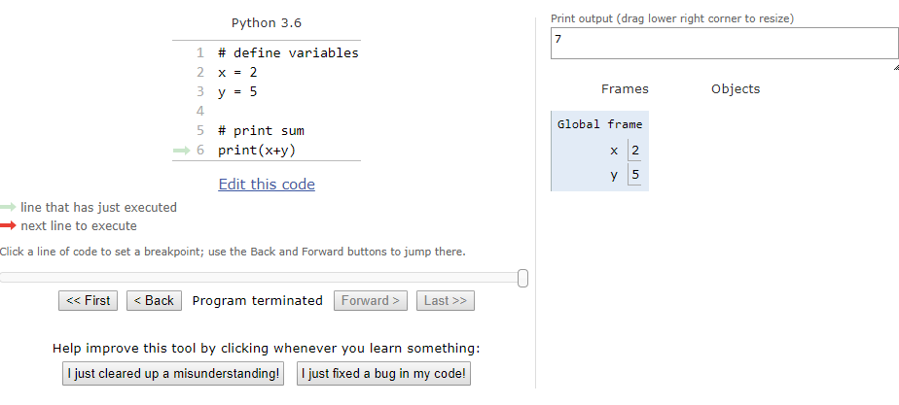
Programming in general
An awesome tool for tracing Python code:
http://www.pythontutor.com/visualize.html#mode=edit

Slide 33

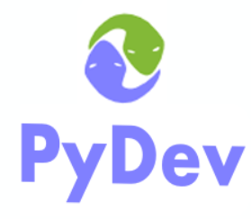
Development environment
After installing Python 3 you will need to install an integrated development environment (IDE)
An IDE is a software application consisting of an editor, build automation tools (e.g. compiler, interpreter), and a debugger
Our preferred IDE is Eclipse. Supports the PyDev interpreter. You will use PyDev in this class

Slide 34
Basic output
One way to print output is to use the built-in function print()
Each print() statement will output on a new line
print('I am a resident of WI.')
print('I study at UW')
I am a resident of WI.
I study at UW
Text enclosed in '' or “” is a string literal
Allowed text in string literals: any letters, numbers, spaces, and any symbols like @#$

Slide 35
Basic output
One way to print output is to use the built-in function print()
Each print() statement will output on a new line
print('I am a resident of WI.')
print('I study at UW')
I am a resident of WI.
I study at UW
How can we move text to the next line without using multiple print() statements?

Slide 36
Basic output
One way to print output is to use the built-in function print()
Each print() statement will output on a new line
print('I am a resident of WI.')
print('I study at UW')
I am a resident of WI.
I study at UW
How can we move text to the next line without using multiple print() statements?
Solution: use the newline escape character \n (should be part of the string!)
print('I\nam\nsmart')
I
am
smart

Slide 37
Basic output
One way to print output is to use the built-in function print()
Each print() statement will output on a new line
print('I am a resident of WI.')
print('I study at UW')
I am a resident of WI.
I study at UW
How can we move text to the next line without using multiple print() statements?
Solution: use the newline escape character \n (should be part of the string!)
print('I \n am \n smart')
II
am.
smart

Slide 38
Basic output
To keep the output on the same line: specify end = ' ' as an argument of the print() function
print('I am a resident of WI.', end = ' ')
print('I study at UW.')
I am a resident of WI. I study at UW.
notice the space

Slide 39
Basic output
How to output a variable's value? Use print(variable) -> without quotes
my_age = 20
print(my_age, end = '')
print('\'s')
20's
no space

Slide 40
Basic output
How to concatenate items within a statement?
my_age = 20
print(my_age)
print('I am a resident of WI.')
print('I am', my_age, 'years old.')
20
I am a resident of WI.
I am 20 years old.
A comma separates multiple items. A comma adds a whitespace on the left side

Slide 41
Basic output
How to concatenate items within a statement?
my_age = 20
print(my_age)
print('I am a resident of WI.')
print('I am' , my_age , 'years old.')
20
I am a resident of WI.
I am 20 years old.
A comma separates multiple items. A comma adds a whitespace on the left side

Slide 42
Basic output
How to concatenate items within a statement?
my_age = 20
print(my_age)
print('I am a resident of WI.')
print('I am' .., my_age…,….'years old.')
20
I am a resident of WI.
I am 20 years old.
A comma separates multiple items. A comma adds a whitespace on the left side

Slide 43
Basic output
How to concatenate items within a statement?
myAge = 20
print(myAge)
print('I am a resident of WI.')
print('I am ' .., myAge…,….'years old.')
20
I am a resident of WI.
I am 20 years old.
A comma separates multiple items. A comma adds a whitespace on the left side

Slide 44
Top Hat Question # 2
What is the output of:
print('2 and 2 =', 4)

Slide 45
Top Hat Question # 3
What is the output of:
print('2 and 2 = ', 4)

Slide 46
Basic input
You can read input using the built-in input() function
Reading from the input() function always results in a string
String v. Integer?
'375' is a string, aka a sequence of characters '3', '7', '5'
375 is an integer, the number three-hundred seventy-five
number = input()
print('My lucky number is', number)
375
My lucky number is 375
Type is string, i.e. '375'

Slide 47
Basic input
You can read input using the built-in input() function
Reading from the input() function always results in a string
String v. Integer?
'375' is a string, aka a sequence of characters '3', '7', '5'
375 is an integer, the number three-hundred seventy-five
number = int(input())
print('My lucky number is', number)
375
My lucky number is 375
Use the built-in int() function to convert string to integer
Type is integer, i.e. 375

Slide 48
Basic input
You can add a prompt in the input() function as well
You can perform operations inside the print() function
number = int(input('Enter your lucky number: '))
print('My lucky number is', number)
Enter your lucky number: 375
My lucky number is 375
Type is integer, i.e. 375
a = int(input())
b = int(input())
print(a * b)
print(a + b)
a = 5
b = 5
25
10

Slide 49
Errors
SyntaxErrors (occur before the program is run by the interpreter, prior to executing code)
day = 4
print(‘Today is July' 4)
File '<main.py>', line 2
print(Today is July' 4)
SyntaxError: invalid syntax
What is missing in the syntax?
RuntimeErrors (occur when the program is run by the interpreter, during code execution)
Types: IdententionError, ValueError, NameError, TypeError
LogicErrors (do not stop the execution of the program but the code does not behave as intended)
print( 2 * 4)
print( 2 * 40)

Slide 50
Top Hat Question # 5
Do you get any error when running this code? If yes, what type of error?
status = 'sunny'
print('Today is' + status)

Slide 51
Chapter 2: Variables and expressions
Variables
Expressions
Objects
Modules

Slide 52
Variables
In programming, a variable is a named item that holds the value of an expression.
Variables are not declared in Python. Their data type is inferred based on the assigned value
Thus, Python is a dynamic typed language
The data type of a variable can change depending on the assigned value
var name
hot_days
hot_days = 5
data type is integer

Slide 53
Variables
Naming Rules:
Start with a letter or underscore (_)
Subsequent characters can be letters, digits, or underscores (_)
Can be any length (but choose shorter and meaningful names)
Case-sensitive: days ≠ Days
Cannot be a keyword used by Python (e.g. print, and, while)
-> Good practice: use all lowercase letters and place underscores between words

Slide 54
Variables
Naming Rules:
Start with a letter or underscore (_)
Subsequent characters can be letters, digits, or underscores (_)
Can be any length (but choose shorter and meaningful names)
Case-sensitive: days ≠ Days
Cannot be a keyword used by Python (e.g. print, and, while)
-> Good practice: use all lowercase letters and place underscores between words
Can assign multiple variables at once (allows for different data types)
hot_days, month = 5, 'June'
hot_days = 5
month = 'June'

Slide 55
Variables
Naming Rules:
Start with a letter or underscore (_)
Subsequent characters can be letters, digits, or underscores (_)
Can be any length (but choose shorter and meaningful names)
Case-sensitive: days ≠ Days
Cannot be a keyword used by Python (e.g. print, and, while)
-> Good practice: use all lowercase letters and place underscores between words
Can assign multiple variables at once (allows for different data types)
Can swap variable values
hot_days, month = 5, 'June'
hot_days, month = month, hot_days
hot_days = 5
month = 'June'
hot_days = 'June'
month = 5

Slide 56
Variables
Naming Rules:
Start with a letter or underscore (_)
Subsequent characters can be letters, digits, or underscores (_)
Can be any length (but choose shorter and meaningful names)
Case-sensitive: days ≠ Days
Cannot be a keyword used by Python (e.g. print, and, while)
-> Good practice: use all lowercase letters and place underscores between words
Can assign multiple variables at once (allows for different data types)
Can swap variable values
Can delete variables
hot_days, month = 5, 'June'
hot_days, month = month, hot_days
del hot_days
del month
hot_days = 5
month = 'June'
hot_days = 'June'
month = 5

Slide 57
Top Hat Question # 8
Write code to swap the values of a and b
a = 2
b = 3
a = 3
b = 2

Slide 58
Data types
Primitive
Non-primitive
Integer
Float
Boolean
String
List
Tuple
Array
Dictionary
Set
File

Slide 59
Data types
Primitive
Non-primitive
Integer
Float
Boolean
String
List
Tuple
Array
Dictionary
Set
File
numeric data types

Slide 60
Numeric data types
Integer: used to represent whole numbers from negative infinity to infinity, like 1, 2, 3 or -1, -2,…
Float: used for rational point numbers, usually ending with a decimal figure, like 1.11 or 2.54
Remember that in Python you don't need to explicitly state the variable type because Python is a dynamically typed language
To find the class of a variable:
type(variable)

Slide 61
Numeric data types
Float: the term 'float' because the decimal point can appear (float) anywhere
Assigning a floating-point value outside of the allocated range results in an OverflowError
To read a float type as an input:
Literals: represent a specific value assigned to a variable (e.g. integer literal, float literal)
float(input('type a float number: ')

Slide 62
Top Hat Question # 6
Which number is not a float?
(a) 1.0
(b) .55
(c) 2.3e2
(d) 4

Slide 63
Variable assignment
The assignment operator (=) assigns a value to a variable
The assignment operator (=) is right-to-left associative
Evaluate expression 2 + 3
Assign the value of expression to var_name
var_name = expression
a = b = c = 2 + 3

Slide 64
Top Hat Question # 7
What is the difference between an expression and an assignment?

Slide 65
Expressions – operators
Unary:
-: negation
Binary:
+: addition
-: subtraction
*: multiplication
/: division
**: exponent
%: reminder (modulo)
Compound:
+=: add and assign (e.g. a += 3 is shorthand for a = a + 3)
Other variants: -=; *=; /=; %=

Slide 66
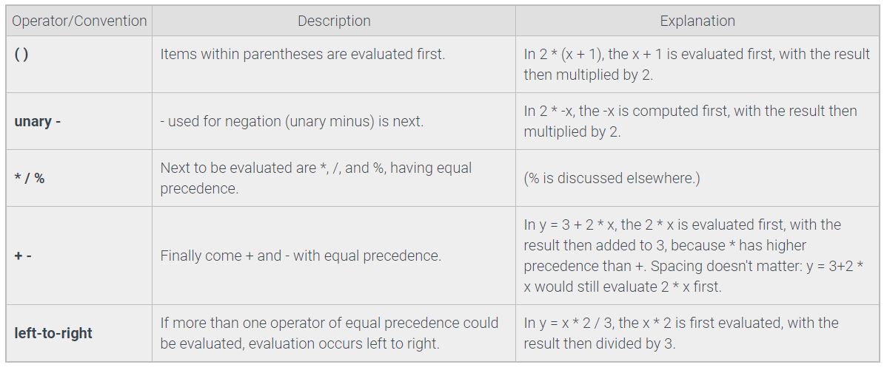
Expressions – operator precedence
An expression is evaluated using the order of standard mathematics
Source: Zybooks, Table 2.5.2

Slide 67
Top Hat Question # 9
What is the result of this expression?
(a) 28
(b) 23
(c) 30
(d) 36
(3 x 2) + (8 + 4) x 2

Slide 68
Expressions – integer division
The division operator (/) returns a floating-point number
The floored division* operator (//) returns:
a floating-point number if either operand is a float
an integer if both operands are integers
*used to round down the result of a floating-point division to the closes whole value
10 / 20
10 / 2
0.5
5.0
10 // 20
10 // 2
5.0 // 2
0
5
2.0

Slide 69
Expressions – modulo operator
The modulo operator (%) evaluates the reminder of the division of two integer operands
10 % 20
10 % 2
10
0

Slide 70
Top Hat Question # 10
What is the result of these expressions?
121.0 // 11
(b) 125/13

Slide 71
Type conversion
Expressions sometimes combine a floating-point and integer
So what is the data type of the result of the expression in this case?
Implicit conversion: implicit cast made by the interpreter to the widest type
Explicit conversion: implicit cast initiated by the programmer using data type methods, such as
int() converts to integer type (if the input is a float number it will chop off the decimal part)
float() convers to float type
str() converts to string type
Integer -> float
Narrowest
Widest

Slide 72
Type conversion
Implicit conversion:
Explicit conversion:
data_type
print(5 + 2.0)
print(5 + 2.2)
print(5 + 2)
print (5 / 2)
print(5 / 5)
7.0
7.2
7
2.5
1.0
float
float
integer
float
float
integer
string
float
print(int(5 / 5))
print(str(5 / 5))
print(float(5 + 2)
1
1.0
7.0

Slide 73
Objects
Are not created by the program!
Instead the Python interpreter creates and manipulates objects
Used to represent everything in Python (e.g. data types (integers, strings, lists), functions))
Let's look at an example…

Slide 74
Objects
Variable names
Objects in memory
The management of the Private Heap is performed by the interpreter itself
On demand allocations by the Python memory manager can be done through the Python/C API functions
Complicated for us, but more info here: https://docs.python.org/3/c-api/memory.html
Global space
Heap space

Slide 75
Objects
Variable names
Objects in memory
age1 = 18
Global space
Heap space
98
age1
18
99

Slide 76
Objects
Variable names
Objects in memory
age1 = 18
age2 = 23.4
Global space
Heap space
age2
23.4
98
age1
18
99

Slide 77
Objects
Variable names
Objects in memory
age1 = 18
age2 = 23.4
age2 = age1
Global space
Heap space
Name binding:
An object can be assigned to multiple variables.
A variable cannot have multiple objects.
age2
23.4
98
age1
18
99

Slide 78

Objects
Garbage collector (deletes objects with no reference to optimize memory)
Variable names
Objects in memory
age1 = 18
age2 = 23.4
age2 = age1
Global space
Heap space
Name binding:
An object can be assigned to multiple variables.
A variable cannot have multiple objects.
age2
23.4
98
age1
18
99

Slide 79
Objects
Garbage collector (deletes objects with no reference to optimize memory)
Variable names
Objects in memory
age1 = 18
age2 = 23.4
age2 = age1
age2 = age2 * 2
Global space
Heap space
36
97
age2
98
age1
18
99
Integers and strings are immutable – modifying their value results in a new object being created

Slide 80
Objects
Garbage collector (deletes objects with no reference to optimize memory)
Variable names
Objects in memory
age1 = 18
age2 = 23.4
age2 = age1
age2 = age2 * 2
combined_age = age1 + age2
Global space
Heap space
54
96
combined_age
36
97
age2
98
age1
18
99

Slide 81
Objects
Garbage collector (deletes objects with no reference to optimize memory)
Variable names
Objects in memory
age1 = 18
age2 = 23.4
age2 = age1
age2 = age2 * 2
combined_age = age1 + age2
# to get object value
print(age1)
Global space
Heap space
object value
54
96
combined_age
36
97
age2
98
age1
18
99

Slide 82
Objects
Garbage collector (deletes objects with no reference to optimize memory)
Variable names
Objects in memory
age1 = 18
age2 = 23.4
age2 = age1
age2 = age2 * 2
combined_age = age1 + age2
# to get object type
print(type(age1))
Global space
Heap space
object type
54 <class 'int'>
96
combined_age
36 <class 'int'>
97
age2
98
age1
18 <class 'int'>
99
Arrows: age1 holds a reference to an object of type int with value 18

Slide 83
Objects
Garbage collector (deletes objects with no reference to optimize memory)
Variable names
Objects in memory
age1 = 18
age2 = 23.4
age2 = age1
age2 = age2 * 2
combined_age = age1 + age2
# to get object identity (memory loc)
print(id(age1))
Global space
Heap space
object
identity
54
96
combined_age
36
97
age2
98
age1
18
99

Slide 84
Module basics
Good programming practice is to have a:
Main script (calls modules)
Modules (can also call other modules)
A module is called by the main script (or other modules) using the import command
main.py
products.py
quantities.py
modules
(imported by the main script or other modules)
main script
(passed as input to the interpreter)
prices.py

Slide 85
Module basics
Good programming practice is to have a:
Main script (calls modules)
Modules (can also call other modules)
A module is called by the main script (or other modules) using the import command
main.py
products.py
# list product categories
import products
print('Store A product is:', products.store_A)
print('Store B product is:', products.store_B)
store_A = 'Organges'
store_B = 'Apples'

Slide 86
Module basics
Good programming practice is to have a:
Main script (calls modules)
Modules (can also call other modules)
A module is called by the main script (or other modules) using the import command
main.py
products.py
# list product categories
import products
print('Store A product is:', products.store_A)
print('Store B product is:', products.store_B)
store_A = 'Organges'
store_B = 'Apples'
# Executes only if run as a main script
if __name__ == '__main__'
print(' Store A product is', store_A)

Slide 87
Module basics
Python comes with a set of standard modules such as Math, Random, Datetime
Check the Python module index here: https://docs.python.org/3/py-modindex.html
A module is a collection of functions, with one or multiple arguments:
To use a module (e.g. math) simply type: import math at the top of the program
floor() and ceil() are functions belonging to the module math
A module is a Python object that you can reference
math.floor(x)
math.ceil(x)
function
argument(s)

Slide 88
The math module
Variable names
Objects in memory
import math
float_no1 = float(input())
Global space
Heap space
97
98
float_no1
3
99

Slide 89
The math module
Variable names
Objects in memory
import math
float_no1 = float(input())
float_no2 = float(input())
Global space
Heap space
97
float_no2
3
98
float_no1
3
99

Slide 90
The math module
Variable names
Objects in memory
import math
float_no1 = float(input())
float_no2 = float(input())
float_pow = math.pow(float_no1, float_no2)
Global space
Heap space
float_pow
27
97
float_no2
3
98
float_no1
3
99

Slide 91
Top Hat Question # 11
Draw a diagram to explain what happens in the memory of the computer when the following code is run:
import math
float_no1 = float(input())
float_no2 = float(input())
float_no2 = float_no1
float_pow = math.pow(float_no1, float_no2)

Slide 92
The math module
Variable names
Objects in memory
import math
float_no1 = float(input())
float_no2 = float(input())
float_no2 = float_no1
float_pow = math.pow(float_no1, float_no2)
Global space
Heap space
float_pow
27
97
float_no2
3
98
float_no1
3
99

Slide 93
Chapter 3: Data types
Sequence data types
Mapping data types

Slide 94
Data types
Primitive
Non-primitive
Integer
Float
Boolean
String
List
Tuple
Array
Dictionary
Set
File
numeric data types
sequence data types

Slide 95
Sequence data types
String: a sequence of characters; strings are immutable with fixed size
List**: a container of (heterogenous) objects; lists are mutable with unlimited size
Tuple**: a container of (heterogenous) objects; tuples are immutable with fixed size
** Sequence types: because objects are ordered by position (index) in the container
Note: Array is also a sequence data type but we will talk about this later in the course.

Slide 96
String basics
Let's talk about characters first …
Visible characters: 'a', 'b', '$', '#'
Escape (special) characters: \\ (backslash), \' (single quote), \'' (double quote), \n (new line), \t (tab, indent) [once the interpreter reaches the (\) character recognizes the start of a special character sequence]
Raw string: place an (r) before the string to ignore escape characters
print('Today is my \'lucky\' day')
Today is my 'lucky' day
print(r'Today is my \'lucky\' day')
Today is my 'Today is my \'lucky\' day)

Slide 97
String basics
Computers can only understand machine code (1001010101010101001)
Python uses standards to represent characters in binary numbers
ASCII table (uses 7-bits to encode a character, http://www.asciitable.com/)
Unicode (let's you choose between UTF-32, UTF-16, UTF-8 bit encodings, https://www.fileformat.info/info/charset/UTF-32/list.htm, https://www.fileformat.info/info/charset/UTF-16/list.htm, https://www.fileformat.info/info/charset/UTF-8/list.htm
Unicode is superior if you have lots of characters to encode (at the expense of larger files…)
Python 2.x code's default encoding is ASCII
Python 3.x code's default encoding is UTF-8

Slide 98
String basics
Computers can only understand machine code (1001010101010101001)
Python uses standards to represent characters in binary numbers
ASCII table (uses 7-bits to encode a character, http://www.asciitable.com/)
Unicode (let's you choose between UTF-32, UTF-16, UTF-8 bit encodings, https://www.fileformat.info/info/charset/UTF-32/list.htm, https://www.fileformat.info/info/charset/UTF-16/list.htm, https://www.fileformat.info/info/charset/UTF-8/list.htm
Unicode is superior if you have lots of characters to encode (at the expense of larger files…)
We are not CS guys, why we should care about all these?

Slide 99
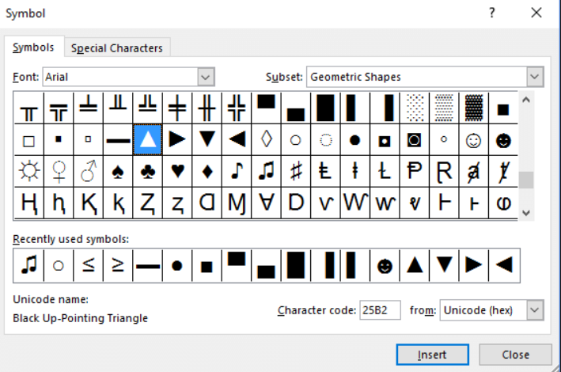
String basics
Not CS… well… true… but (just an example) what if you want to write characters that are not supported by a physical keyboard?
Someone 'magically' created a user friendly interface to imbed special characters in Excel, PP etc.

Slide 100
String basics
Not CS… well… true… but (just an example) what if you want to write characters that are not supported by a physical keyboard?
Someone 'magically' created a user friendly interface to imbed special characters in Excel, PP etc.
How do we 'magically' imbed these special characters in Python code?
Two useful built-in functions:
chr() to convert an encoded value to a character
ord('') to convert a character to the encoded value

Slide 101
String basics
Not CS… well… true… but (just an example) what if you want to write characters that are not supported by a physical keyboard?
Someone 'magically' created a user friendly interface to imbed special characters in Excel, PP etc
How do we 'magically' imbed these special characters in Python code?
Suppose you want to write: 'bună' (means 'hello' in Romanian)
print('b' + 'u' + 'n' + chr(259))
bună

Slide 102
String basics
100000011
259 is still not a binary number (aka base 2 no.). It's actually a decimal number (aka base 10 no.)
The Python interpreter translates this decimal number into binary number (machine code)
How? see zyBooks Chapter 3.9: 'Binary numbers' for an explanation
… enough with characters, let's now see what is a String

Slide 103
String basics
A string is a sequence of characters
A string literal is created by surrounding characters with single (' ') or double quotes (“ ”)
The string type is a sequence data type, meaning that:
The elements (characters) of a string are ordered (indexed) from left to right
Indexing starts at 0
0 1 2 3 4 5 6 7 8 9 10
H
e
l
l
o
w
o
r
l
d
my_string = 'hello world'

Slide 104
String basics – memory representation
String names
Objects in memory
my_string = 'Hello world'
Global space
Heap space
97
98
my_string
'Hello world'
99

Slide 105
Top Hat Question # 12
What is the index of 'd' in 'Hello world'?

Slide 106
Top Hat Question # 13
Draw a diagram to explain what happens in the memory of the computer when the following code is run (include type of data in the explanation)
my_string = 'Hello world'
my_number = 5
my_number = 5 * 2

Slide 107
String basics
Built-in functions:
len(string) – returns number of characters in my_string;
chr('a') – returns the integer 97 representing the Unicode code point of the 'a' character
Built-in methods:
string.upper() – returns a copy of string with all the cased characters converted to uppercase
string.lower() – returns a copy of string with all the cased characters converted to lowercase
string.capitalize() – returns a copy of string with its first character capitalized and rest lowercased
More on Python built-in functions here:
https://docs.python.org/3.7/library/functions.html
More on Python built-in methods here:
https://docs.python.org/3/library/stdtypes.html#textseq

Slide 108
Functions
Methods
is a block of code that is also called by its name (independent)
can have different parameters or may not have at all
if any data parameters are passed, they are passed explicitly
it may or may not return any data
do not deal with Class and its instance
concept
Is called by its name, but its functions are associated with an object (dependent)
A method is implicitly passed the object in which it‘s invoked
It may or may not return any data
can operate on the data (instance variables) that is contained by the corresponding class

Slide 109
Top Hat Question # 14
What is the output?
my_string = 'Hello world'
my_number = 5
my_number = 5 * 2
print(my_string.upper())

Slide 110
String basics – accessing characters
my_string[index] – character at given index (counts indexing from left to right)
my_string[-index] – character at given index (counts indexing from right to left)
0 1 2 3 4 5 6 7 8 9 10
my_string = 'Hello world'
print(len(my_string))
print(my_string[4]) print(my_string[-4])
11
'o'
'o'
H
e
l
l
o
w
o
r
l
d
-11 -10 -9 -8 -7 -6 -5 -4 -3 -2 -1

Slide 111
String basics – add, change, remove characters
String objects are immutable! Meaning that we cannot add, change, or remove a character
string1 = 'Today'
string2 = ' is 4th of July.'
string2[16] = 'n'
string2[17] = 'e'

Slide 112
String basics – add, change, remove characters
String objects are immutable! Meaning that we cannot add, change, or remove a character
Instead, update a character by assigning a new string
string1 = 'Today'
string2 = ' is 4th of July.'
string2[16] = 'n'
string2[17] = 'e'
string2 = ' is 4th of June'

Slide 113
String basics – concatenation
Using the addition (+) sign
string1 = 'Today'
print(string1)
string2 = ' is 4th of July.'
print(string2)
concat_string = string1 + string2
print(concat_string)
Today
is 4th of July
Today is 4th of July

Slide 114
Top Hat Question # 15
What is the length of the following string. What is the value at index 3?
my_string = 'I need a break! '

Slide 115
Top Hat Question # 16
What is the output of the print function? Explain.
my_string = 'I need a break! '
my_string[0] = 'W'
my_string[1] = 'e'
print(my_string)

Slide 116
String basics – formatting
How can we augment the ability of the built-in print() function?
Concepts:
conversion specifier
conversion operator
conversion type
Precision
Minimum field width
'0' conversion flag
format()
Adam will cover this topic in the Lab session. More info on zyBooks Ch 7.2 and 7.5

Slide 117
Data types
Primitive
Non-primitive
Integer
Float
Boolean
String
List
Tuple
Array
Dictionary
Set
File
numeric data types
sequence data types

Slide 118
List basics
A list is a container initialized with brackets [ ]
Elements of a list are comma (,) separated
Elements of a list can be heterogenous, i.e. of different types
Elements of a list are ordered by position (index) in the container, meaning that
A list is a sequence data type
Example: my_list = ['a', 123, 'b']
Example of empty list: my_empty_list = [ ]
A list is mutable, meaning that one can add, remove, and edit its elements

Slide 119
List basics – accessing elements
Similar to strings, list elements are accessed by index (remember list is a sequence data type)
my_list = ['a', 123, 'b']
print('The first element in my list is', my_list[0], '.')
The first element in my list is a .

Slide 120
List basics – add, change, remove elements
The list data type is a mutable object!
We can add, change, ore remove elements of a list using built-in methods:
list.append(x) – ads element x to the end of the list
list.remove(x) – removes the first element from the list whose value is equal to x
list.pop(index) – removes the element at the given index in the list, and returns it; if no index is specified removes and returns the last item in the list
my_list = ['a', 123, 'b']
my_list.append('abc')
print(my_list)
my_list.remove('a')
print(my_list)
my_list.pop(2)
print(my_list)
['a', 123, 'b', 'abc']
[123, 'b', 'abc']
[123, 'b']
Notice that the list output is always enclosed by brackets!
Reason: lists can be nested (more on this later)

Slide 121
List basics – add, change, remove elements
Check here for more list related built-in methods:
https://docs.python.org/3/tutorial/datastructures.html#more-on-lists
The list data type is a mutable object!
We can add, change, ore remove elements of a list using built-in methods:
list.append(x) – ads element x to the end of the list
list.remove(x) – removes the first element from the list whose value is equal to x
list.pop(index) – removes the element at the given index in the list, and returns it; if no index is specified removes and returns the last item in the list

Slide 122
List basics – concatenation
Lists are concatenated using the (+) sign. Question: how do we concatenate strings?
list1 = ['a', 123, 'b']
list2 = ['a']
print(list2 + list1)
['a', 'a', 123, 'b']

Slide 123
Top Hat Question # 17
What is the output of the print function? Explain.
list1 = ['a', 123, 'b']
list2 = ['a']
list2 = list1
print(list2 + list1)

Slide 124
List basics – memory representation
List names
Objects in memory
my_list = ['a', 123, 'b']
Global space
Heap space
The interpreter creates new object for each element in the list. Each object is indexed
97
'a'
0
123
1
99
my_list
'b'
2
Arrow meaning: my_list holds references to objects in list

Slide 125
List basics
Built-in functions:
len(list) – returns the length of the list
min(list) – returns the element with the smallest value in the list (numeric types only)
max(list) – returns the element with the largest value in the list (numeric types only)
sum(list) – returns the sum of all elements of a list (numeric types only)
More built-in methods:
list.index(x) – returns the index of the first element in the list whose value is equal to x
list.count(x) – returns the number of times x appears in the list
More on Python built-in functions here:
https://docs.python.org/3.7/library/functions.html
More on Python built-in methods here:
https://docs.python.org/3/tutorial/datastructures.html#more-on-lists

Slide 126
Top Hat Question # 18
What is the output?
list1 = ['a', 123, 'b']
list1.count('a')

Slide 127
Data types
Primitive
Non-primitive
Integer
Float
Boolean
String
List
Tuple
Array
Dictionary
Set
File
numeric data types
sequence data types

Slide 128
Tuple basics
A tuple is a container initialized with parenthesis () or no parenthesis (safe to add them)
Elements of a tuple are comma (,) separated
Elements of a tuple can be heterogenous, i.e. of different types
Elements of a tuple are ordered by position (index) in the container, meaning that:
A tuple is a sequence data type
Looks pretty much like a list but is more memory efficient
Example: my_tuple = ('a', 123, 'b')
Example of empty list: my_empty_tuple = ()
A tuple is immutable, meaning that one cannot add, remove, and edit its elements

Slide 129
Tuple basics – accessing elements
Similar to lists (and strings), tuple elements can be accessed by index
my_tuple = ('a', 123, 'b')
print('The first element in my list is', my_tuple[0], '.')
print(my_tuple)
The first element in my list is a .
('a', 123, 'b')
Notice that the tuple output is always enclosed by brackets!
Reason: tuples can be nested (more on this later)

Slide 130
Tuple basics – accessing elements
When to use tuples? When you want to make sure that the values do not change. Remember that tuples are immutable objects, so you cannot change, add, or delete values.
Similar to lists (and strings), tuple elements can be accessed by index
my_tuple = ('a', 123, 'b')
print('The first element in my list is', my_tuple[0], '.')
print(my_tuple)
The first element in my list is a .
('a', 123, 'b')

Slide 131
Tuple basics – accessing elements
The package** collections implements specialized sequence data types providing alternatives to built-in sequence data types (namedtuple is a specialized version of tuple)
The namedtuple() function in the collection package assigns meaning to each position in a tuple and allow for more readable, self-documenting code.
To import the package and the function: from collections import namedtuple
**A package in Python is a collection of modules and functions
Tuple elements can also be accessed by attribute name. This type of tuple is a namedtuple

Slide 132
Tuple basics – accessing elements
Tuple elements can also be accessed by attribute name. This type of tuple is a namedtuple
# import namedtuple from collections package
from collections import namedtuple
# generate the named tuple
Airplane = namedtuple('Airplane', ['make', 'model', 'price']) #price is in million US dollars
# generate different airplane objects
boeing_737= Airplane('boeing', 737, 134.9)
boeing_777= Airplane('boeing', 777, 442.2)
# list the price of boeing_737
print(boeing_737.price)
More on syntax here:
https://docs.python.org/2/library/collections.html#collections.namedtuple

Slide 133
Tuple basics – memory representation
Tuple names
Objects in memory
my_tuple = ('a', 123, 'b')
Global space
Heap space
The interpreter creates new object for each element in the tuple. Each object is indexed
97
'a'
0
123
1
99
my_tuple
'b'
2
Arrow meaning: my_tuple holds references to objects in list

Slide 134
Tuple basics – memory representation
Tuple names
Objects in memory
my_tuple = ('a', 123, 'b')
my_tuple2 = ()
Global space
Heap space
my_tuple2
97
'a'
0
123
1
99
my_tuple
'b'
2
Arrow meaning: my_tuple holds references to objects in list.
my_tuple2 is an empty set

Slide 135
Tuple basics – memory representation
Tuple names
Objects in memory
# import collections and namedtuple
from collections import namedtuple
# generate the named tuple
Airplane = namedtuple('Airplane', ['make', 'model', 'price’])
Global space
Heap space
boeing_777
98
boeing_737
99
Airplane
namedtuple() only creates the Airplane class (more on this later) and its corresponding data types

Slide 136
Tuple basics – memory representation
Tuple names
Objects in memory
# import collections and namedtuple
from collections import namedtuple
# generate the named tuple
Airplane = namedtuple('Airplane', ['make', 'model', 'price’])
# generate different airplane objects
boeing_737= Airplane('boeing', 737, 134.9)
boeing_777= Airplane('boeing', 777, 442.2)
# list the price of boeing_737
print(boeing_737.price)
Global space
Heap space
boeing_777
'boeing'
'make'
777
'model'
98
442.2
'price'
boeing_737
'boeing'
'make'
737
'model'
99
Airplane
134.9
'price'
namedtuple() only creates the Airplane class (more on this later) and its corresponding data types

Slide 137
Top Hat Question # 19
Write code to compute the sum of the price of boeing 737 and boeing 777
# import collections and namedtuple
from collections import namedtuple
# generate the named tuple
Airplane = namedtuple('Airplane', ['make', 'model', 'price')
# generate different airplane objects
boeing_737= Airplane('boeing', 737, 134.9)
boeing_777= Airplane('boeing', 777, 442.2)
# list the price of boeing_737
print(boeing_737.price)

Slide 138
Data types
Primitive
Non-primitive
Integer
Float
Boolean
String
List
Tuple
Array
Dictionary
Set
File
numeric data types
sequence data types
mapping data type

Slide 139
Dictionary basics
A dictionary is a container used to describe associative relationships between keys (words) and values (definitions)
It's initialized with curly brackets {} that surround the key : value pairs
Multiple key : value pairs are separated by comma (,)
The keys can be any immutable type, e.g. numeric, string, tuple
The values can be of any type
Example: airplanes= {'boeing737' : 134.9, 'boeing777' : 442.2}
dictionary name

Slide 140
Dictionary basics
A dictionary is a container used to describe associative relationships between keys (words) and values (definitions)
It's initialized with curly brackets {} that surround the key : value pairs
Multiple key : value pairs are separated by comma (,)
The keys can be any immutable type, e.g. numeric, string, tuple
The values can be of any type
Example: airplanes= {'boeing737' : 134.9, 'boeing777' : 442.2}
key
key

Slide 141
Dictionary basics
A dictionary is a container used to describe associative relationships between keys (words) and values (definitions)
It's initialized with curly brackets {} that surround the key : value pairs
Multiple key : value pairs are separated by comma (,)
The keys can be any immutable type, e.g. numeric, string, tuple
The values can be of any type
Example: airplanes= {'boeing737' : 134.9, 'boeing777' : 442.2}
value
value

Slide 142
Dictionary basics
A dictionary is a container used to describe associative relationships between keys (words) and values (definitions)
It's initialized with curly brackets {} that surround the key : value pairs
Multiple key : value pairs are separated by comma (,)
The keys can be any immutable type, e.g. numeric, string, tuple
The values can be of any type
Example: airplanes= {'boeing737' : 134.9, 'boeing777' : 442.2}
Example empty dictionary: airplanes = { }

Slide 143
Dictionary basics
A dictionary is a mapping data type, so not a sequence data type (!)
This means that elements of a dictionary do not maintain any specific ordering
A dictionary is a mutable object meaning that one can add, remove, and edit its elements
products = {'GM seed': 120, 'Conv' : 87}
print(products)
{'GM seed' : 120, 'Conv : 87'}
Notice that the dictionary output is always enclosed by
curly brackets!
Reason: dictionaries can be nested (more on this later)

Slide 144
Dictionary basics – accessing elements
Dictionary elements can only be accessed by key name (no index -> no ordering of entries)
What if you try to access a key that doesn't exist in the dictionary?
products = {'GM seed': 120, 'Conv' : 87}
print('The price of GM seed is', products['GM seed'])
The price of GM seed is 120
products = {'GM seed': 120, 'Conv' : 87}
print('The price of GM seed is', products['IR seed'])
Traceback (most recent call last): File "<stdin>", line 2, in <module>
KeyError: 'IR seed'

Slide 145
Top Hat Question # 20
What is the output?
products = {
('GM seed', 'Conv seed'): (120, 140),
'Conv' : 87
}
print(products['GM seed']

Slide 146
Top Hat Question # 21
What is the output?
products = {
('GM seed', 'Conv seed'): (120, 140),
'Conv' : 87
}
print(products['GM seed', 'Conv seed'])

Slide 147
Dictionary basics - add, change, remove elements
The dictionary data type is a mutable object!
To add a key : value pair in the dictionary, assuming the key : value pair doesn't already exist
To change a value belonging to an existing key
To remove a key, assuming the key already exists
products['IR seed'] = 110
products['Conv'] = 50
del products['GM seed']

Slide 148
Dictionary basics – memory representation
Dictionary name
Objects in memory
airplanes = {
'boeing737' : 134.9,
'boeing777' : 442.2
}
Global space
Heap space
98
134.9
'boeing737'
99
airplanes
442.2
'boeing777'

Slide 149
Top Hat Question # 22
Write code to compute the sum of the price of boeing 737 and boeing 777
airplanes = {
'boeing737' : 134.9,
'boeing777' : 442.2
}

Slide 150
Data types
set data type
Primitive
Non-primitive
Integer
Float
Boolean
String
List
Tuple
Array
Dictionary
Set
File
numeric data types
sequence data types
mapping data type

Slide 151
Set basics
A set is a container of unordered (no indexing!) and unique elements
Initialization can be done in two ways:
Using the built-in set() function, which accepts only sequence-type objects (string, list, tuple)
Using the set literal with curly brackets {}; elements are separated by a comma (,)
Unique elements: duplicate values are removed when passed into the set
Sets are mutable objects, meaning that one can add or remove elements
Example using the set() function: my_set = set(['a', 'b', 'c'])
Example using the set literal: my_set = {'a', 'b', 'c'}
Example of an empty set: my_set = set( ) -> note: an empty set can be only created with set()
If you type my_set = { }, then an empty dictionary will be created!

Slide 152
Set basics
More examples
my_set = set(['a', 'b', 'c', 'd', 'c', 'a'])
print(my_set)
{'c', 'a', 'b'}
No specific ordering. Run the code again and you might see a different ordering
Notice that the set output is always enclosed by
curly brackets!
Reason: sets can be nested (more on this later)

Slide 153
Set basics – adding or removing elements
The set data type is a mutable object!
We can add or remove elements of a set using methods included in the set() function:
set.add(x) – add element x to set
set.remove(x) - remove element x from set; raises KeyError if not present
set.pop() – remove and return an arbitrary element from set; raises KeyError if set is empty
set.clear() – remove all elements from set; the resulting set is an empty set (of length 0)
set.update(set_a) – returns set with elements added from set_a
Check here for more set related objects here:
https://docs.python.org/3/library/stdtypes.html#set-types-set-frozenset

Slide 154
Set basics – adding or removing elements
The set data type is a mutable object!
We can add or remove elements of a set using methods included in the set() function
airplanes = set(['boeing 737', 'boeing 777'])
cars = set(['VW Tiguan', 'VW Passat'])
cars.add('VW Tuareg')
airplanes.update(cars)
transportation = airplanes
print(transportation)
{'boeing 737', 'VW Passat', 'VW Tiguan', 'boeing 777', 'VW Tuareg'}

Slide 155
Set basics – memory representation
Set names
Objects in memory
airplanes = set(['boeing 737', 'boeing 777'])
Global space
Heap space
98
airplanes
'boeing 737' 'boeing 777'
99

Slide 156
Set basics – memory representation
Set names
Objects in memory
airplanes = set(['boeing 737', 'boeing 777'])
cars = set(['VW Tiguan'])
Global space
Heap space
cars
'VW Tiguan'
98
airplanes
'boeing 737' 'boeing 777'
99

Slide 157
Set basics – memory representation
Variable names
Objects in memory
airplanes = set(['boeing 737', 'boeing 777'])
cars = set(['VW Tiguan'])
cars.add('VW Passat')
Global space
Heap space
cars
'VW Tiguan' 'VW Passat'
98
airplanes
'boeing 737' 'boeing 777'
99

Slide 158
Set basics – memory representation
Variable names
Objects in memory
airplanes = set(['boeing 737', 'boeing 777'])
cars = set(['VW Tiguan'])
cars.add('VW Passat')
airplanes.update(cars)
Global space
Heap space
cars
'VW Tiguan' 'VW Passat'
98
'boeing 737' 'boeing 777'
'VW Tiguan' 'VW Passat'
99
airplanes

Slide 159
Set basics – memory representation
Variable names
Objects in memory
airplanes = set(['boeing 737', 'boeing 777'])
cars = set(['VW Tiguan'])
cars.add('VW Passat')
airplanes.update(cars)
transportation = airplanes
Global space
Heap space
transportation
cars
'VW Tiguan' 'VW Passat'
98
'boeing 737' 'boeing 777'
'VW Tiguan' 'VW Passat'
99
airplanes

Slide 160
Set basics – memory representation
Variable names
Objects in memory
airplanes = set(['boeing 737', 'boeing 777'])
cars = set(['VW Tiguan'])
cars.add('VW Passat')
airplanes.update(cars)
transportation = airplanes
cars.clear()
Global space
Heap space
transportation
cars
98
'boeing 737' 'boeing 777'
'VW Tiguan' 'VW Passat'
99
airplanes
Note: cars is now an empty set

Slide 161
Set basics – memory representation
Variable names
Objects in memory
airplanes = set(['boeing 737', 'boeing 777'])
cars = set(['VW Tiguan'])
cars.add('VW Passat')
airplanes.update(cars)
transportation = airplanes
cars.clear()
airplanes.clear()
Global space
Heap space
transportation
cars
98
airplanes
99
Note: cars, transportation, airplanes are now empty sets

Slide 162
Set basics – memory representation
Variable names
Objects in memory
airplanes = set(['boeing 737', 'boeing 777'])
cars = set(['VW Tiguan'])
cars.add('VW Passat')
airplanes.update(cars)
transportation = airplanes
cars.clear()
Global space
Heap space
transportation
cars
98
'boeing 737' 'boeing 777'
'VW Tiguan' 'VW Passat'
99
airplanes
Note: cars is now an empty set

Slide 163
Set basics – memory representation
Variable names
Objects in memory
airplanes = set(['boeing 737', 'boeing 777'])
cars = set(['VW Tiguan'])
cars.add('VW Passat')
airplanes.update(cars)
transportation = airplanes
cars.clear()
transportation.clear()
Global space
Heap space
transportation
cars
98
airplanes
99
Note: cars, transportation, airplanes are now empty sets
Empty sets have len(set) = 0

Slide 164
Set basics – set theory operations
The set data type supports common set theory operations, such as:
We can add or remove elements of a set using methods included in the set() function:
set.intersection(set_a, set_b) – returns a set with all elements in common between set and set_a, set_b
set.union(set_a, set_b) – returns a set containing all of the unique elements in all sets
Check here for more set related built-in objects here:
https://docs.python.org/3/library/stdtypes.html#set-types-set-frozenset

Slide 165
Top Hat Question # 23
Add question related to sets

Slide 166
Chapter 4: Branches
Conditional statements
Boolean statements
Membership and identity operators
Code blocks and indentation
Conditional expressions

Slide 167
Conditional statements
The if statement:
condition
if (condition):
true statement
.
.
last true statement
true
True
statement block
false
Following statements

Slide 168
Conditional statements
The if-else statement:
condition
if (condition):
true statement
.
.
last true statement
else:
false statement
.
.
false statement
true
false
True
statement block
False
statement block
Following statements

Slide 169
Conditional statements
The if-else if statement:
condition1
true
True
statement block
if (condition1):
true statement
.
.
last true statement
elif (condition2):
true statement
.
.
true statement
else:
false statement
.
.
false statement
false
condition2
true
True
statement block
false
False
statement block
Following statements

Slide 170
Boolean statements
Boolean values: True or False (capitalized!)
Boolean operators: and, or, not
and: true when both operands are true
or: true when at least one operand is true
not: True (False) when the single operand is False (True)
Boolean expression: an expression that uses Boolean operators
Examples of Boolean expressions:
(age > 16) and (age <25)
(age < 16) and (days < 8)
(age > 16) or (days > 7)
not (days > 6)
True and True -> True
False and True -> False
True or False -> True
not (True) -> False
age = 18, days = 7

Slide 171
More on data types
set data type
Primitive
Non-primitive
Integer
Float
String
Boolean
Array
List
Tuple
Dictionary
Set
File
numeric data types
sequence data types
mapping data type

Slide 172
Boolean statements
Comparison operators: (expression1 comparison operator expression2), e.g. (age > 16)
Equality comparison:
==: equal to
!=: not equal to
Relational comparison:
>: greater than
<: less than
>=: greater than or equal
<=: less than or equal
a < b < c: operator chaining ( b > a?, b < c?; note that a is never compared to c)

Slide 173
Boolean statements
Operator chaining: You can rent a car if you are between 21 and 81 years old (inclusive)
age = int(input('What is your age?: '))
if (age >= 21) and (age <= 81):
print('You can rent a car')
25
Boolean operator is and
Chaining performs comparisons left to right:
(age >= 21) is True
(age <= 81) is True
The Boolean expression evaluates to True
The print statement is: You can rent a car

Slide 174
Top Hat Question # 24
What is printed out in the following code block?
to_be = False
if (to_be or (not to_be)):
print('Tautology')
else:
print('Contradiction')

Slide 175
Boolean statements
What data types can be compared?
Integers and floating-points
Strings
Lists and tuples
Dictionaries

Slide 176
Boolean statements
What data types can be compared?
Integers and floating-points: arithmetically compared
Strings: compared by converting each character to a number value (ASCII or Unicode) and then comparing each character in order
2 > 3
2.0 == 2.0
2 > 3 is False
floating-number are imprecisely represented. ==, != comparisons are not recommended
'Tue' == 'Wed'
T == W: 84 == 87 is False
Source: https://en.wikipedia.org/wiki/List_of_Unicode_characters

Slide 177
Boolean statements
What data types can be compared?
Lists and tuples: compared via an ordered comparison of every element in the sequence
Dictionaries: compared by sorting the keys and values of each dictionary and then comparing them as lists
price1 = [50, 60, 75]
price2 = [50, 60, 85]
price1 == price2
price1[1] == price2[1] is True
price1[2] == price2[2] is True
price1[3] == price2[3] is False
The expression evaluates to False
products1 = {'GM seed': 120, 'Conv' : 87}
products2 = {'GM seed': 120, 'Conv' : 88}
See next page for solution

Slide 178
Boolean statements
What data types can be compared?
Dictionaries: compared by sorting the keys and values of each dictionary and then comparing them as lists
products1 = {'GM seed': 120, 'Conv' : 87}
products2 = {'GM seed': 120, 'Conv' : 88}
#return dictionary keys
keys1 = sorted(products1.keys())
keys2 = sorted(products2.keys())
# return dictionary values
value1 = sorted(products1.values())
print(value1)
value2 = sorted(products2.values())
print(value2)
# print messages
if(keys1 == keys2):
print("The keys are the same")
if(value1 == value2):
print('The values are also the same')
else:
print('The values are not the same')
else:
print('The keys are not the same')
Notes:
sorted() is a built-in function
dictionary.keys() is a dictionary method
dictionary.values() is a dictionary method

Slide 179
Boolean statements
Why are Boolean operators (and, or, not) important in programming?

Slide 180
Boolean statements
Why are Boolean operators (and, or, not) important in programming?
They are commonly used in expressions found in if-else statements!
To understand loops you need to understand Booleans.
How do you code “I cannot rent a car if I am less than 21 years old and more than 81 years old” using Boolean operators?
age = int(input('Enter driver\'s age: ')
if (age >= 21) and (age <= 81):
print('I can rent a car')
else:
if (age < 21):
print('Too young to rent a car')
else:
print('Too old to rent a car')

Slide 181
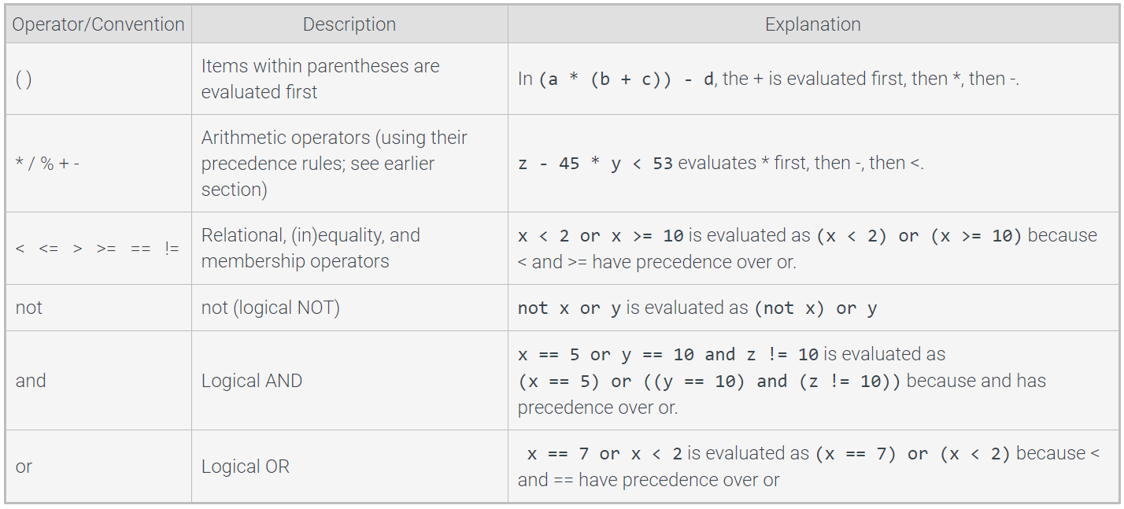
Boolean statements – operator precedence
An expression is evaluated using the order of standard mathematics
Source: Zybooks, Table 4.7.1

Slide 182
Top Hat Question # 25
What is the output?
integer = 4
if(integer > 4 + 2):
print('integer is greater than 4')
integer = 4 + 2
else:
print('integer is not greater than 4. The integer value is', integer, '.')

Slide 183
Top Hat Question # 26
What is the output if input is 33?
age = int(input())
if(age ==18):
print('ready for college?')
elif(age == 22):
print('ready for grad school?')
else:
if(age < 18):
print('too young')
else:
print('you are probably in grad school or already have a job')

Slide 184
Membership operators
Membership operators: in / not in
Why are membership operators important? Or how we can make use of them?

Slide 185
Membership operators
Membership operators: in / not in
Why are membership operators important? Or how we can make use of them?
Many times we want to know if a specific value exists in a container (eg. list, tuple, dictionary), or if a substring is part of a string
For example, what do you do if you only want to keep the rows in a list for which prices > 99?
in / not in operands yield True or False if the left operand matches the value on the right side

Slide 186
Membership operators
Membership operators: in / not in
Why are membership operators important? Or how we can make use of them?
Many times we want to know if a specific value exists in a container (eg. list, tuple, dictionary)
For example, what do you do if you only want to keep the rows in a list for which prices > 99?
in / not in operands yield True or False if the left operand matches the value on the right side
prices = [100, 55, 66, 75, 99]
return_value = 99 in prices
print(return_value)
<every element in the list is checked for the value of 99>
True

Slide 187
Top Hat Question # 27
What is the output of the print statement?
prices = [100, 55, 66, 75, '99']
return_value = 99 in prices
print('It is', return_value)

Slide 188
Top Hat Question # 28
Write code to check if 'GM seeds' is in the products dictionary keys. Print statement if True is 'We are lucky'. Print statement if False is 'Try next time!'
products = {'GM seed': 120, 'Conv' : 87}
'''
Your solution here
'''

Slide 189
Top Hat Question # 28
Write code to check if 'GM seeds' is in the products dictionary keys. Print statement if True is 'We are lucky'. Print statement if False is 'Try next time!'
products = {'GM seed': 120, 'Conv' : 87}
if 'GM seed' in products.keys():
print('We are lucky')
else:
print('Try next time!')

Slide 190
Identity operators
Identity operators: is / is not
Why are identity operators important? Or how we can make use of them?

Slide 191
Identity operators
Identity operators: is / is not
Why are identity operators important? Or how we can make use of them?
What if we want to determine if two variables are the same object (i.e. share the same value)?
Identity operators do not compare object value! They compare object identities, which is the memory address of the object.
Identity operators return True if the operands reference the same object
prices = [100, 55, 66, 75, 99]
return_value = 99 is prices[4]
print(return_value)
<the interpreter checks if 99 and prices[4] are identical objects>
True

Slide 192
Code blocks and indentation
A code block in Python is defined by its indentation level
Highly recommended to use 4 spaces per indentation level
Either use spaces or tabs for indentation (never both!). It's very likely you will end up with an IndentationError if you use both!

Slide 193
Code blocks and indentation
A code block in Python is defined by its indentation level
Highly recommended to use 4 spaces per indentation level
Either use spaces or tabs for indentation (never both!). It's very likely you will end up with an IndentationError if you use both!
prices = [100, 55, 66, 75, 99]
return_value = 99 in prices
if(return_value == True)
print('the index of element 99 in list is', list.index[99])
else:
print('Element 99 is not in list')
print('Try another number')

Slide 194
Code blocks and indentation
A code block in Python is defined by its indentation level
Highly recommended to use 4 spaces per indentation level
Either use spaces or tabs for indentation (never both!). It's very likely you will end up with an IndentationError if you use both!
Not more than 80 columns or 120 columns of text. Split code on multiple lines if necessary
prices = [100, 55, 66, 75, 99]
return_value = 99 in prices
if(return_value == True)
print('the index of element 99 in list is', list.index[99])
else:
print('Element 99 is not in list')
print('Try another number')

Slide 195
Top Hat Question # 29
What is the output if input is 33?
age = int(input())
if(age ==18):
print('ready for college?')
elif(age == 22):
print('ready for grad school?')
else:
if(age < 18):
print('too young')
else:
print('you are probably in grad school or already have a job')

Slide 196
Conditional expressions
Similar to if-else statements
But harder to read in general…
Not more than 80 columns or 120 columns of text. Split code on multiple lines if necessary
expression_when_true if condition else expression_when_false
salary = 1000 if (age >= 18) else salary = 0
2. The if-else equivalent is:
if(age <= 18):
salary = 1000
else:
salary = 0

Slide 197
References
Programming languages types
Source: https://www.youtube.com/watch?v=1OukpDfsuXE
Eclipse logo
Source: https://www.eclipse.org/
PyDev logo
Source: https://www.pydev.org/
Garbage collector picture
Source: www.zybooks.com

